Slide 1
Questioned Documents
Forensic Science

Slide 2
Copyright and Terms of Service
Copyright © Texas Education Agency, 2011. These materials are copyrighted © and trademarked ™ as the property of the Texas Education Agency (TEA) and may not be reproduced without the express written permission of TEA, except under the following conditions:
1) Texas public school districts, charter schools, and Education Service Centers may reproduce and use copies of the Materials and Related Materials for the districts’ and schools’ educational use without obtaining permission from TEA.
2) Residents of the state of Texas may reproduce and use copies of the Materials and Related Materials for individual personal use only, without obtaining written permission of TEA.
3) Any portion reproduced must be reproduced in its entirety and remain unedited, unaltered and unchanged in any way.
4) No monetary charge can be made for the reproduced materials or any document containing them; however, a reasonable charge to cover only the cost of reproduction and distribution may be charged.
Private entities or persons located in Texas that are not Texas public school districts, Texas Education Service Centers, or Texas charter schools or any entity, whether public or private, educational or non-educational, located outside the state of Texas MUST obtain written approval from TEA and will be required to enter into a license agreement that may involve the payment of a licensing fee or a royalty.
Contact TEA Copyrights with any questions you may have.
Copyright © Texas Education Agency 2011. All rights reserved.
Images and other multimedia content used with permission.

Slide 3
Questioned Document
Any document about which some issue has been raised, or that is the subject of an investigation

Slide 4
Document Examiners
Mostly examine handwriting to originate its source or its authenticity
Will also examine typed writings, computer printings, photocopies, inks, papers, and forgeries, and decode altered and charred documents
May need to use microscopes, photographs, chromatography, and other lab examinations on the questioned documents
Many work in federal, local, and state crime labs, but they may also work in private practices

Slide 5
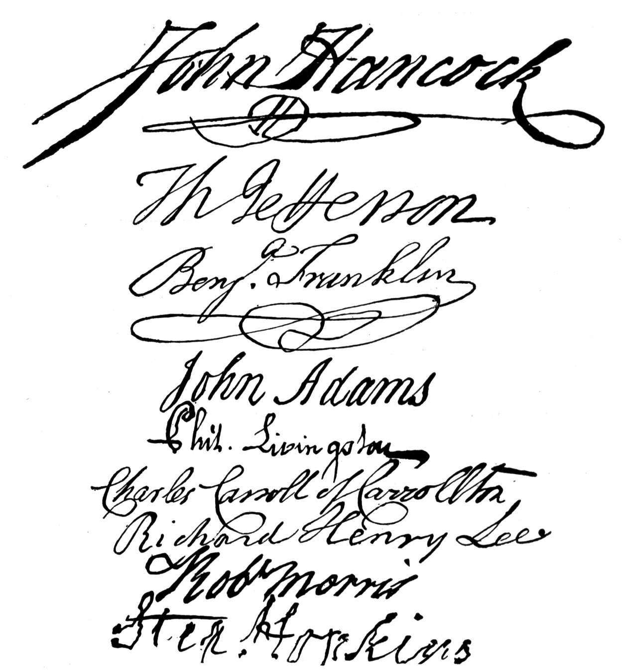
Handwriting
General Information
Two individual’s cannot have identical handwriting
Since handwriting is associated with mechanical, physical, and mental functions, it is almost impossible to reproduce exactly
Handwriting can be almost as individual as a person’s fingerprint

Slide 6
Handwriting (continued)
Examining and Comparing
A positive comparison must be based on an ample number of common characteristics between known and questioned writings
Collecting a lot of exemplars (known writings) is critical in order to make a comparison
Exemplars should contain some of the same words or combinations of letters that are present in the questioned document(s)

Slide 7
Handwriting (continued)
Forensic Information System of Handwriting database (FISH)
If the document is a part of a high profile case or is suspected to be written by a repeat offender, the document may be scanned into the FISH database
This database is maintained by the U.S. Secret Service
It can provide a list of “hits” based on mathematical values calculated from the scanned images, but a document examiner makes the final confirmation or elimination

Slide 8
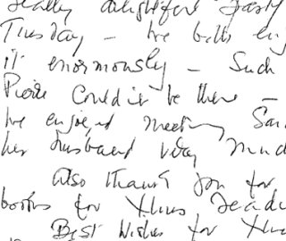
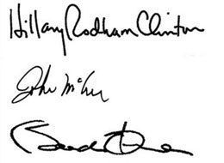
Handwriting (continued)
The 12 factors examiners use to determine authenticity
Average amount of space between words and letters
Relative height, width and size of letters
The height of letters including the comparison of the height of the uppercase and lowercase letters
The width of letters and the space between letters and words
The size of letters relative to the available space

Slide 9
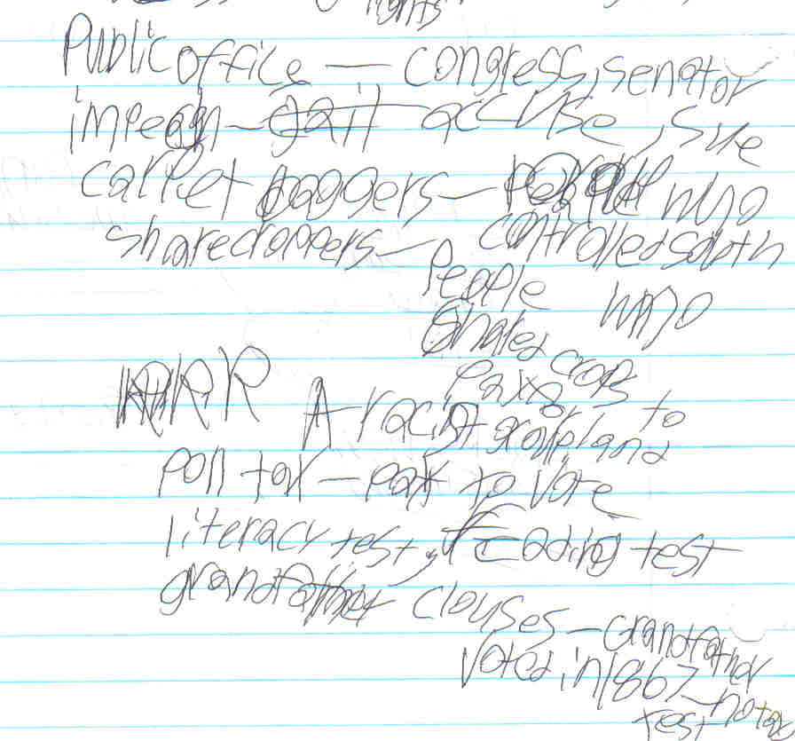
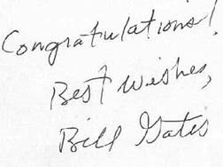
Handwriting (continued)
12 factors examiners use to determine authenticity (continued)
Line quality – observing if the lines are smooth, free-flowing, or shaky and wavering
Connecting strokes – comparing the strokes between upper and lower case letters, and the strokes between the letters and the words
Beginning and ending strokes – observing how the writer begins and ends words, numbers, and letters

Slide 10
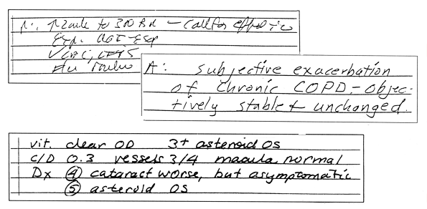
Handwriting (continued)
12 factors examiners use to determine authenticity (continued)
Pen lifts and separations
How the writer stops to form new letters and begin words
Forgeries may have lifts or separations in unusual places, such as within a letter
Shading and pen pressure – the differing amounts of pressure used by the writer that make lines light or dark, narrow or wide
Baseline habits – analyzing if the writer’s letters stay straight or move up and down compared to a baseline

Slide 11
Handwriting (continued)
12 factors examiners use to determine authenticity (continued)
Slant – analyzing the writing slant: left, right, or straight
Unusual letter formation – such as letters with tails or letters written backwards, etc.
Flourishes or embellishments – any fancy letters, curls, loops, circles, etc.
Letter characteristics
Completeness of closed characters such as, o, e, and a
Dotting of i and j, and crossing of t

Slide 12
Handwriting (continued)
Factors that can affect handwriting samples
Writing instrument (pens, pencils, crayons, etc.)
Writing surface (paper, wall, napkin, etc.)
Underlining surface (smooth or rough)
Mood of the writer (happy, depressed, angry, etc.)
Age of the writer (undeveloped or shaky handwriting)
Writing speed (slow or quick)

Slide 13
Handwriting (continued)
Factors that can affect handwriting samples (continued)
Position of the writer (sitting or standing)
Position of the document (flat, vertical, or horizontal surface)
Environmental exposure (temperature, humidity, etc.)
Other factors
Consumption of alcohol and/or drugs
Injuries and/or illnesses

Slide 14
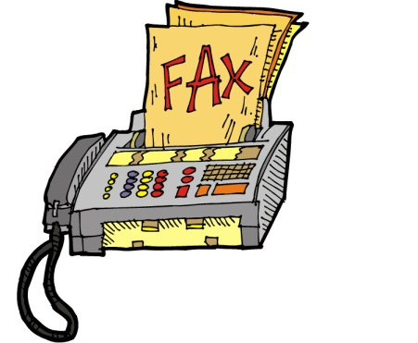
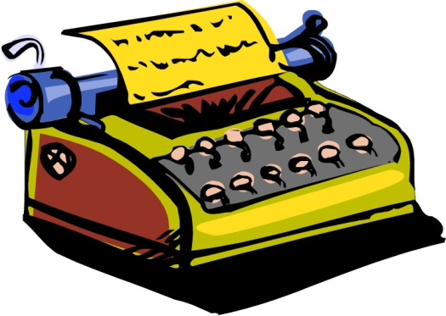
Typescript Comparisons
Typescript is the result of machine-created documents, such as computer printers, photocopiers, fax machines, and typewriters
Defects, missing pieces, or scratches may help to identify the machine where the document originated

Slide 15
Typescript Comparisons (continued)
Computer printers – the kind of ink and toner
Photocopiers – the debris patterns
Fax machines – have a Transmitting Terminal Identifier (TTI)
Typewriters
Characteristics of the typeface, characters, and the ribbon
The Haas Atlas is a typewriter catalog

Slide 16
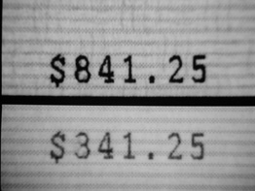
Altered Documents
Documents are often altered after they have been prepared. This is sometimes done to hide the original content or commit a forgery
Additions
Adding content to an already prepared document
Infrared luminescence
Emits infrared light when exposed to blue-green light
Can be used to get results if a different ink is used then the one on the original document

Slide 17
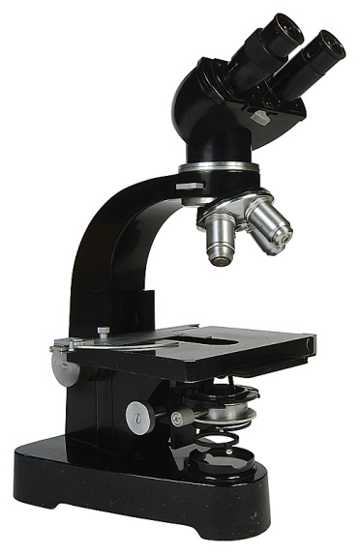
Altered Documents (continued)
Erasures
One of the most common alterations
An rubber eraser, sandpaper, razor blade, or knife may be scratched against the paper’s surface in an attempt to remove writing or type
This irritates the top fibers of the paper which are visible under a microscope

Slide 18
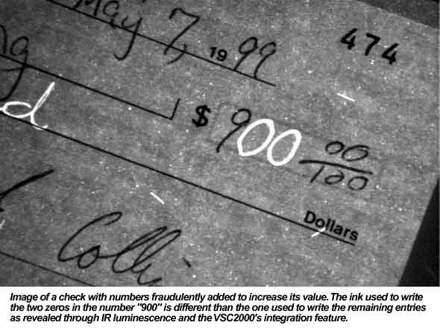
Altered Documents (continued)
Obliterations
A document may have parts that are blotted or smeared, making the original unreadable
This is usually done with strong oxidizing agents to make the ink become colorless
This is not visible to the naked eye, but can be seen with microscopes, or ultraviolet or infrared lighting

Slide 19
Altered Documents (continued)
Charred Documents
Sometimes documents are accidently or purposely charred in a fire
Infrared photography or reflecting light at different angles can sometimes reveal the document’s contents

Slide 20
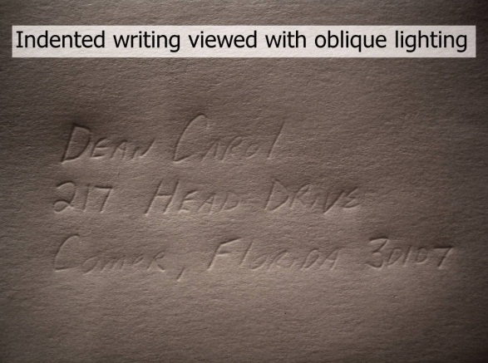
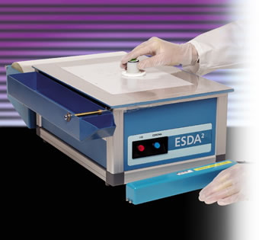
Other Document Challenges
Indentations
Most of the time an indented impression is left on a paper below the primary writing
The best way to read the impression is by using an ESDA (Electrostatic Detection Apparatus)
This charges the paper
Pouring toner powder over the charged paper develops the images on the indented paper

Slide 21
Other Document Challenges (continued)
Paper
To identify paper, scientists may use the following characteristics
Color
Density
Watermarks
Dyes or bleaches
Fluorescence under UV light
Raw material the paper is made from
Thickness

Slide 22
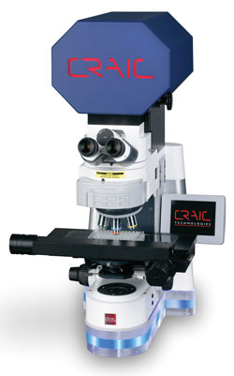
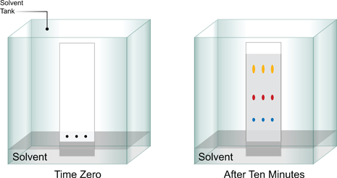
Other Document Challenges (continued)
Ink
Considered a mixture, so it can be broken down into the different chemical components using the following lab tests
Thin Layer Chromatography (TLC)
A visible microspectrophotometer
Studying the chemical composition can sometimes determine
If a certain pen was used on a questioned document
How long the ink has been on the paper
Thin Layer Chromatography (TLC)
Microspectrophotometer

Slide 23
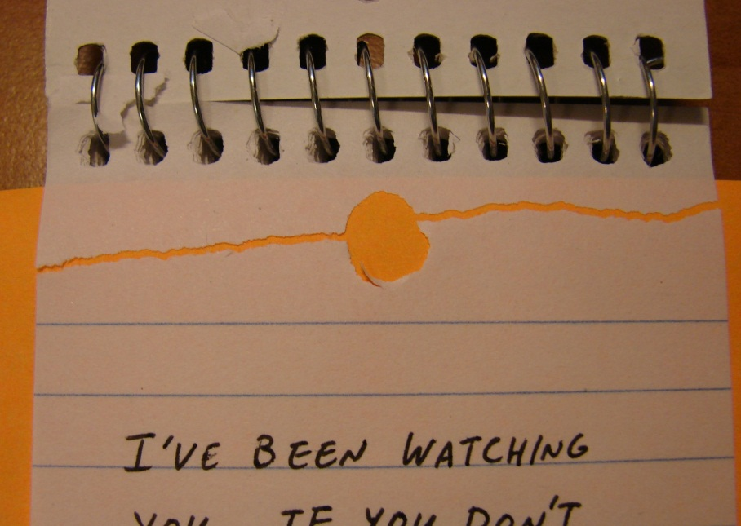
Other Document Challenges (continued)
Physical/Fracture Match of separated documents – usually these documents are cut or torn and can be linked to the original source

Slide 24
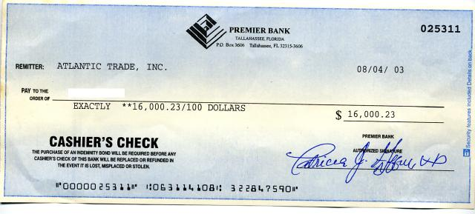
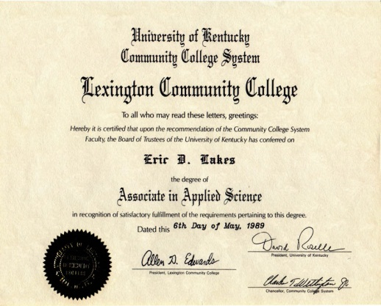
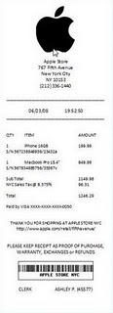
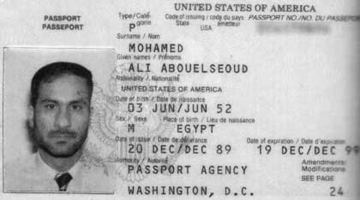
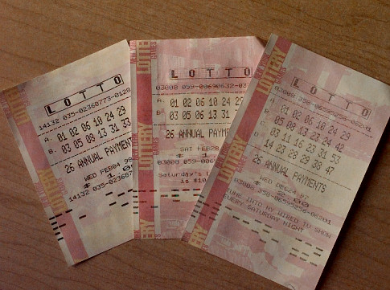
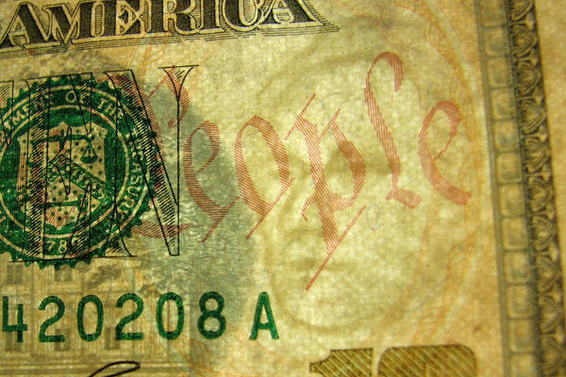
Examples of Questioned Documents
Checks
Licenses and Certificates
Passports
(Counterfeit) Money
Receipts
Lottery tickets
Historical documents
Ransom and suicide notes

Slide 25
Forgery
An item prepared with the intent to deceive
Types
Blind forgery – made without a model of the signature or the writing being forged
Simulated forgery – one made by copying a genuine signature
Traced forgery – one made by tracing a genuine signature

Slide 26
Counterfeit
Made in exact imitation of something important or valuable with the intention of deceit
Columbia
The leading manufacturer of counterfeit U.S. currency
This counterfeit production supports their growing drug cartel

Slide 27
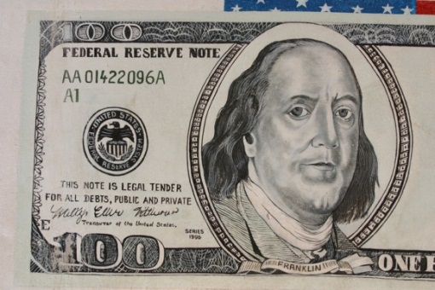
Counterfeit (continued)
The U.S. Bureau of Engraving and Printing has established some anti-counterfeiting security features including
Watermarks
Color-shifting inks
Fine-line printing and microprinting
Enlarged, off-center portraits
Poor vision feature
Denomination-specific security thread

Slide 28
Counterfeit (continued)
Counterfeit detection pen – a security feature that businesses use to help eliminate receiving counterfeit bills
The pen contains iodine, and when it is used on a counterfeit bill it produces a blue-black color
When used on an authentic bill, it produces a pale yellow color that fades over time

Slide 29
Resources
American Society of Questioned Document Examiners www.asqde.org
Deslich, Barbara, and John Funkhouser. Forensic Science for High School. Dubuque, IA: Kendall/Hunt, 2006.
Saferstein, Richard. Forensic Science: An Introduction. Upper Saddle River, NJ: Prentice Hall, 2008.
Texas Education Agency, Forensic Certification Training: Module 9, Sam Houston State University
Do an Internet search for the following: Ted Kaczynski: The Unabomber by Ted Ottley

