Slide 1

Firearms & Tool Marks
Forensic Science

Slide 2
Copyright and Terms of Service
Copyright © Texas Education Agency, 2011. These materials are copyrighted © and trademarked ™ as the property of the Texas Education Agency (TEA) and may not be reproduced without the express written permission of TEA, except under the following conditions:
1) Texas public school districts, charter schools, and Education Service Centers may reproduce and use copies of the Materials and Related Materials for the districts’ and schools’ educational use without obtaining permission from TEA.
2) Residents of the state of Texas may reproduce and use copies of the Materials and Related Materials for individual personal use only, without obtaining written permission of TEA.
3) Any portion reproduced must be reproduced in its entirety and remain unedited, unaltered and unchanged in any way.
4) No monetary charge can be made for the reproduced materials or any document containing them; however, a reasonable charge to cover only the cost of reproduction and distribution may be charged.
Private entities or persons located in Texas that are not Texas public school districts, Texas Education Service Centers, or Texas charter schools or any entity, whether public or private, educational or non-educational, located outside the state of Texas MUST obtain written approval from TEA and will be required to enter into a license agreement that may involve the payment of a licensing fee or a royalty.
Contact TEA Copyrights with any questions you may have.

Slide 3
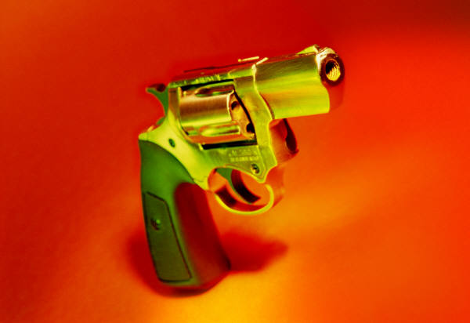
Type of Firearms
  Handguns
    Pistol – a handheld firearm
    Revolver – a pistol with a revolving cylinder (features several firing chambers within the cylinder)
    Semiautomatic – a pistol with a clip-fed mechanism that fires one shot per pull of the trigger; the empty cartridge ejects and the next cartridge advances automatically (features a removable magazine)
    Fully-automatic – a firearm with a clip-fed mechanism that fires repeatedly and for as long as the trigger is held down

Slide 4
Type of Firearms (continued)
  Long Guns may be single-shot, repeating, semi-automatic, or automatic
    Examples
      Rifle – a firearm that has a long barrel; a long gun

Slide 5
Type of Firearms (continued)
  Shotgun – uses shell ammunition that contains numerous ball-shaped projectiles, called shot
    The narrowing of the smooth barrel, called the choke of the shotgun, can concentrate the shot when fired
    Gauge is the diameter of the shotgun barrel; originally the number of lead balls having the same diameter as the barrel that would weigh a pound
    The higher the gauge number, the smaller the barrel’s diameter
    The only exception is the .410 shotgun, in which bore size is 0.41 inches

Slide 6
Discharging the Firearm
  Pulling the trigger releases the weapon’s firing pin, causing it to strike the primer – the primer ignites the powder
  The expanding gases generated by the burning gunpowder propel the bullet forward through the barrel
  The shell is impressed with markings by its contact with the metal surfaces of the weapon’s firing and loading mechanisms
  Impressions found on the weapon and markings found on the bullet are used by forensic scientists for examination and comparison

Slide 7
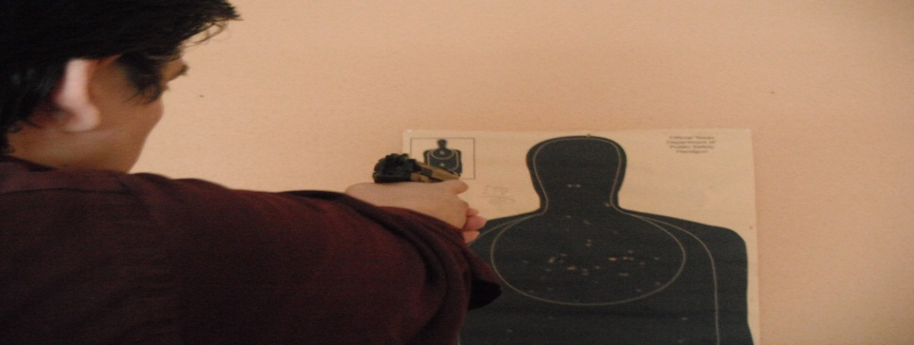
Firearm Analysis
  Gun Barrel Markings
    The barrel’s inner surface leaves its markings on any bullet that passes through it (these markings are unique to each gun)
    The gun barrel is produced from a solid bar of steel that has been hollowed out by drilling
    The microscopic drill marks left on the barrel’s inner surface are randomly irregular and make each barrel unique

Slide 8
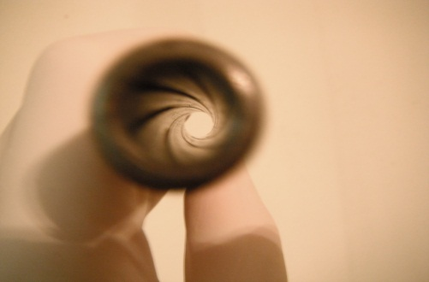
Firearm Analysis (continued)
  Gun Barrel Markings (continued)
    Barrels are also manufactured with spiral grooves, known as rifling
    The parts of the original bore left between the grooves are called lands
    The grooves guide a fired bullet through the barrel, giving it a rapid spin to insure accuracy
    The grooves guide the bullet through the barrel, giving it a rapid spin to ensure accuracy

Slide 9
Firearm Analysis (continued)
  Gun Barrel Markings (continued)
    The diameter of the gun barrel, measured between opposite lands, is known as the caliber (expressed in hundredths of an inch or millimeters – for example, .22 caliber or 9 millimeter)
    Once a manufacturer chooses a rifling process, the class characteristics of the weapon’s barrel will remain consistent
    Each will have the same number of lands and grooves, with the same approximate width and direction of twist

Slide 10
Firearm Analysis (continued)
  Striations
    Fine lines in the interior of the barrel
    Impressed into the metal as the negatives of minute imperfections found on the rifling cutter’s surface
    Or produced by minute chips of steel pushed against the barrel’s inner surface by a moving broach cutter
    Striations form the individual characteristics of the barrel
    The inner surface of the barrel leaves its striation markings on any bullet passing through it

Slide 11
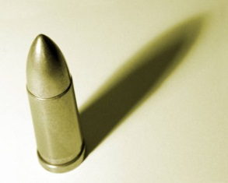
Firearm Analysis (continued)
  Bullets
    No two rifled barrels, even those manufactured in succession, will have identical striation markings
    The number of lands and grooves, and their direction of twist, are easy points of comparison during the initial stages of an examination between an evidence bullet and a test-fired bullet
    Any differences in these class characteristics immediately eliminate the possibility that both bullets traveled through the same barrel

Slide 12
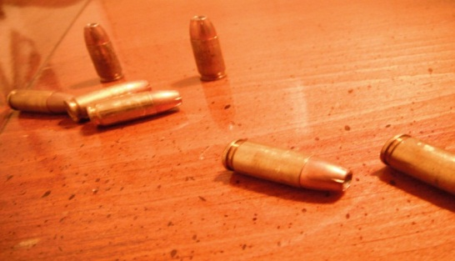
Firearm Analysis (continued)
  Cartridge Comparison
    The firing pin, breechblock, and ejector and extractor mechanism also create distinctive signatures on cartridge cases
    The shape of the firing pin will be impressed into the relatively soft metal of the primer on the cartridge case
    The cartridge case, travelling rearward, is impressed with the surface markings of the breechblock

Slide 13
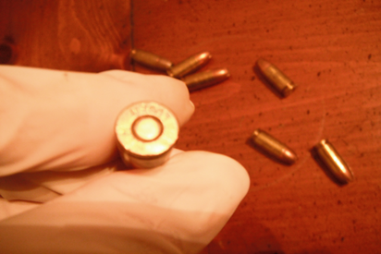
Firearm Analysis (continued)
  Cartridge Comparison (continued)
    Other distinctive markings that may appear on the shell as a result of metal-to-metal contact are caused by the
      Ejector –the mechanism on a firearm that throws the cartridge or fired case from the firearm
      Extractor – the mechanism by which the cartridge of a fired case is withdrawn from the firing chamber
      Magazine or clip –the mechanism that holds the bullets

Slide 14

Identification
  Comparison Microscope
    The single most important tool for a firearms examiner
    Two bullets can be observed and compared simultaneously within the same field of view
    Not only must the lands and grooves of the test and evidence bullet have identical widths, but the longitudinal striations on each must be the same

Slide 15
Identification (continued)
  Computerized Imaging
    Computerized imaging technology has made it possible to store bullet and cartridge surface characteristics similarly to automated fingerprint files
    The National Integrated Ballistics Information Network (NIBIN) produces database files from bullets and cartridge casings retrieved from crime scenes or test fires from retrieved firearms, often linking a specific weapon to multiple crimes
    It is important to remember, however, that the ultimate decision for making a final comparison must be determined by the forensic examiner through traditional microscopic methods

Slide 16
Residue
  Firearm Residue
    Gunshot residue (GSR) – tiny particles expelled from a firearm when it is fired
    When a firearm is discharged, the bullet, unburned and partially burned particles of gunpowder, and smoke are propelled out the barrel toward the target
    If the muzzle of the weapon is sufficiently close, these products will be deposited onto the target
    The distribution of gunpowder particles and other residues around a bullet hole allows for an estimation of the distance from which a handgun or rifle was fired

Slide 17
Residue (continued)
  Firearm Residue (continued)
    The precise distance from which a handgun or rifle has been fired is determined through careful comparison of the powder-residue pattern located on the victim’s clothing or skin against test patterns the suspect weapon males when fired at varying distances from a target
    By comparing the test and evidence patterns, the examiner may find enough similarity in shape and density to formulate an opinion about the distance from which the shot was fired

Slide 18
Residue (continued)
  Firearm Residue (continued)
    When the weapon is held in contact with (or less than 1 inch from) the target, it creates a star-shaped (stellate) tear pattern around the bullet hole entrance, rimmed by a smokeless deposit of vaporous lead
    A halo of vaporous lead (smoke) deposited around a bullet hole normally indicates a discharge of 12 to 18 inches or less
    Scattered specks of unburned and partially burned powder grains without any accompanying soot are often observed at distances up to 25 inches (and occasionally as far as 36 inches)

Slide 19
Residue (continued)
  Firearm Residue (continued)
    More than 3 feet will not usually result in deposits of powder residue, and the only visual indication will be a dark ring around the hole, known as a bullet wipe
    When garments or other evidence relevant to a shooting are taken to the crime laboratory, the surfaces of all items are first examined microscopically for the presence of gunpowder residue

Slide 20

Residue (continued)
  Firearm Residue (continued)
    Chemical tests, such as the Greiss test, may be needed to detect gunpowder residues that are not visible
    The firing distances for shotguns must again be determined through test firing. The muzzle to target distances can be established by measuring the spread of the discharged shot

Slide 21
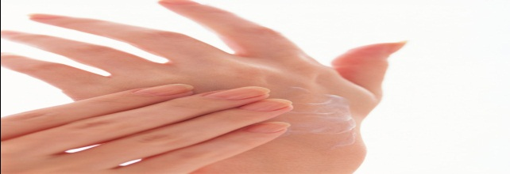
Residue (continued)
  Primer Residue on Hands
    Firing a weapon also propels residues back toward the shooter
    Traces of these residues are often deposited on the shooter’s firing hand, and detection can provide valuable information as to whether an individual has recently fired a weapon

Slide 22
Residue (continued)
  Primer Residue on Hands (continued)
    Examiners measure the amount of barium and antimony on the suspect’s hands, particularly the thumb web, the back of the hand, and the palm
    They may also characterize the morphology of particles containing these elements to determine whether a person has fired, handled, or was near a discharged firearm

Slide 23
Trajectory
  Is the flight path of a projectile
  Can be calculated by finding two reference points along the flight path of the projectile
  The reference points can be a bullet hole in an object, such as a wall or a window, or a bullet wound on a victim

Slide 24
Trajectory (continued)
  Investigators
    Look for clues at a crime scene to help calculate a bullet’s trajectory and figure out where a shooter discharged the firearm
    Might position the corpse (in cases involving a victim’s body) as it was at the time of impact and use a metal or wooden dowel to indicate the path of the bullet
    Can also use lasers to trace straight paths to determine the position of the shooter or shooters

Slide 25
Trajectory (continued)
  Gravity and Trajectory
    Two major forces are acting on a bullet once it is fired: the forward force of the gunshot and the downward force of gravity
    A bullet begins to drop as it leaves the barrel of a firearm
    If the shot is taken at a very distant object, the line of sight of the target must be adjusted to compensate for the effect of gravity on the bullet
    If the target is closer, there would be less adjustment
    Wind speed and direction are also factors affecting adjustments the shooter must make to hit the target

Slide 26
Trajectory (continued)
  Locating the Shooter (Example)
    A bullet is shot and found in a vehicle
    The bullet first penetrated the front driver’s side window and then the seat
    The bullet may have come from a building across the street
    Police need to recreate the crime scene and determine the path of the bullet using the hole in the car’s window and the bullet hole in the seat as their reference points
    Using a laser beam, they project a line creating the approximate trajectory path of the bullet from the building to the car

Slide 27
Trajectory (continued)
  Locating the Shooter (Example) (continued)
    Investigators must also measure the distance from the car to the building
    To determine the position of the shooter, they must determine the distance between the shooter and the bullet hole in the car seat
    This requires at least two reference points from which to project a line back to the source (the shooter in the building)
    To determine the distance between the shooter and the hole in the car seat, investigators must set up a direct proportion using the two right angles

Slide 28
Trajectory (continued)
  Calculation (Distance vs. Drop)
    Measure how many feet the bullet hole is above the ground
    Attempt to locate the bullet’s origin, and measure the distance from the two reference points
    Measure the horizontal distance from the broken window to the bullet hole horizontally and compare this distance to the diagonal length of the bullet path from the hole in the car’s window to the bullet hole

Slide 29

Trajectory (continued)
  Calculation (Distance vs. Drop) (continued)
    Distance to the window = Distance to the shooter (c)
    Distance along horizon Distance to the side of the building
    c = _____
    c (the hypotenuse) = the distance to the shooter
    a = distance to the building
    b = the height of the shooter from the horizon (not from the ground)
    c² = a² + b²
    b = ____in. ~ ____ft.

Slide 30
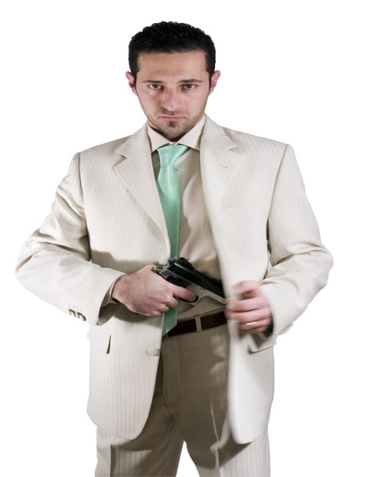
Trajectory (continued)
  Calculation (Distance vs. Drop) (continued)
    Compare the distance from the building with the height of the bullet hole (determined in step # 6) and the horizon
    With this information the investigator can determine where the shooter was, and at what height (or floor) the bullet originated

Slide 31
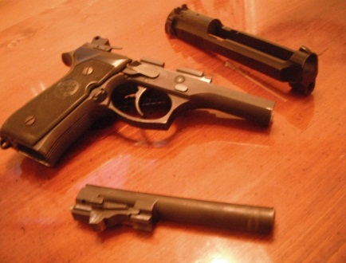
Firearm Evidence Collection
  Firearms are collected by holding the weapon by the edge of the trigger guard or the checkered portions of the grip
  Before the weapon is sent to the laboratory, all precautions must be taken to prevent accidental discharge of a loaded weapon (in most cases, it will be necessary to unload the weapon)
  When a revolver is recovered, the chambers, their positions, and corresponding cartridges must be recorded
  Firearm evidence must be marked for identification (usually a tag on the trigger guard), and a chain of custody must be established

Slide 32
Firearm Evidence Collection (continued)
  Bullets recovered at the crime scene are scribed with the investigator’s initials, either on the base or the nose of the bullet
  The obliteration of striation markings that may be present on the bullet must be scrupulously avoided
  The investigator must protect the bullet by wrapping it in tissue paper before placing it in a pillbox or an envelope for shipment to the crime laboratory
  Fired casings must be identified with the investigator’s initials placed near the outside or inside mouth of the shell
  Discharged shotgun shells are initialed on the paper or plastic tube or on the metal nearest the mouth of the shell

Slide 33
Tool Marks and Other Impressions
  Tool Marks
    A tool mark is any impression, cut, gouge, or abrasion caused by a tool coming into contact with another object
    A careful examination of the impression can reveal important class characteristics, such as the size and shape of the tool
    It is the presence of minute imperfections on a tool that imparts individuality to it
    The shape and pattern of such imperfections are further modified by damage and wear during the life of the tool

Slide 34
Tool Marks and Other Impressions (continued)
  Tool Marks (continued)
    The comparison microscope is used to compare crime scene tool marks with test impressions made with the suspect tool
    When practical, the entire object or the part of the object bearing the tool mark should be submitted to the crime laboratory for examination
    Under no circumstances should the crime scene investigator attempt to fit the suspect tool into the tool mark
    Any contact between the tool and the marked surface may alter the mark and will, at the least, raise serious questions about the integrity of the evidence

Slide 35
Tool Marks and Other Impressions (continued)
  Other Impressions
    Abrasion mark – a mark produced when a surface slides across another surface
    Cutting mark – a mark produced along the edge as a surface is cut
    Indentation mark – a mark or impression made by a tool on a softer surface
    Impressions of other kinds, such as shoe, tire, or fabric, may be important evidence
    Before any impression is moved or otherwise handled, it must be photographed (including scale) to show all the observable details of the impression

Slide 36
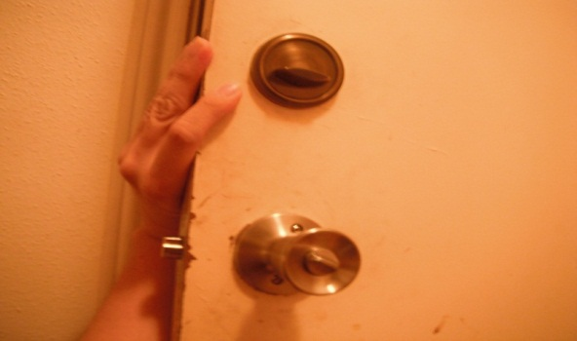
Tool Marks and Other Impressions (continued)
  Other Impressions (continued)
    If the impression is on a readily recoverable item, such as glass, paper, or floor tile, the evidence is transported intact to the laboratory
    If the surface cannot be submitted to the laboratory, the investigator may be able to preserve the impression in a manner similar to lifting a fingerprint

Slide 37
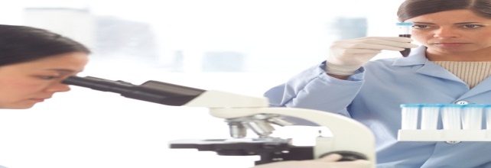
Tool Marks and Other Impressions (continued)
  Other Impressions (continued)
    When shoe and tire marks are impressed into soft earth at a crime scene, their preservation is best accomplished by photography and casting
    In areas where a bloody footwear impression is very faint or where the subject has tracked through blood, leaving a trail of bloody impressions, chemical enhancement can visualize latent or nearly invisible blood impressions

Slide 38
Points of Comparison
  A sufficient number of points of comparison, or the uniqueness of such points, will support a finding that both the questioned and test impressions originated from the same source
  New computer software and websites may be able to assist in making shoeprint and tire impression comparisons
  Also, bite mark impressions on skin and foodstuffs have proven to be important evidence in a number of homicide and rape cases

Slide 39
Resources
Texas Education Agency, Forensic Certification Training, Sam Houston State University
Forensic Science: Fundamentals & Investigation (1st Edition), Anthony Bertino
Forensic Science: From the Crime Scene to the Crime Lab (1st Edition), Richard Saferstein
The Science Spot – Forensic Science http://www.sciencespot.net/Pages/classforsci.html
http://www.americanfirearms.org/history.php
http://www.pbs.org/opb/historydetectives/technique/gun-timeline/
http://library.thinkquest.org/04oct/00206/text_casestudies.htm
http://www.innocenceproject.org/docs/DNA_Exonerations_Forensic_Science.pdf
Investigator/Officer’s Personal Experience
To find the video lectures do an Internet search for the following:
      CSI and “Impressions” Richard Saferstein
      CSI and Firearms Richard Saferstein

