Slide 1

Forensic Anthropology
Forensic Science

Slide 2
Copyright and Terms of Service
Copyright © Texas Education Agency, 2011. These materials are copyrighted © and trademarked ™ as the property of the Texas Education Agency (TEA) and may not be reproduced without the express written permission of TEA, except under the following conditions:
1) Texas public school districts, charter schools, and Education Service Centers may reproduce and use copies of the Materials and Related Materials for the districts’ and schools’ educational use without obtaining permission from TEA.
2) Residents of the state of Texas may reproduce and use copies of the Materials and Related Materials for individual personal use only, without obtaining written permission of TEA.
3) Any portion reproduced must be reproduced in its entirety and remain unedited, unaltered and unchanged in any way.
4) No monetary charge can be made for the reproduced materials or any document containing them; however, a reasonable charge to cover only the cost of reproduction and distribution may be charged.
Private entities or persons located in Texas that are not Texas public school districts, Texas Education Service Centers, or Texas charter schools or any entity, whether public or private, educational or non-educational, located outside the state of Texas MUST obtain written approval from TEA and will be required to enter into a license agreement that may involve the payment of a licensing fee or a royalty.
Contact TEA Copyrights with any questions you may have.

Slide 3
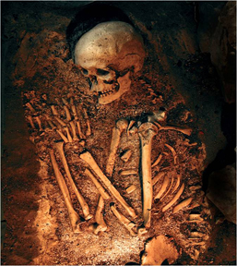
Forensic Anthropology
  The study of skeletonized human remains and the time of death to try to establish the identity and cause of death of an individual

Slide 4
Forensic Anthropology (continued)
Can possibly identify the following
  Age
  Sex
  Race
  Height
  Pathologies that may be present
  Whether trauma is evident

Slide 5

Forensic Anthropology (continued)
When bones are found, the following should be answered:
  Are they really bones or some other type of material?
  Are they human bones?
  Is there only one individual present or more than one?
  How long have the bones been there?
  What is the cause of death?
  Who is this?

Slide 6
Forensic Anthropology:
Age Determination
Sutures
  Zigzag-like cracks on the skull
  Are separate at birth, but gradually close from the inside out
  The older the individual, the less visible the sutures
In toddlers and infants, length of the long bones are measured and compared to known growth curves
After age 21, age is estimated by the level of change on the surfaces of the bones

Slide 7
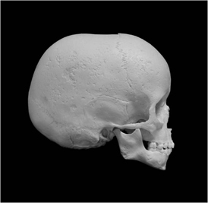
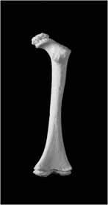
Forensic Anthropology:
Age Determination (continued)
Infant skull with sutures visible
End of this femur is rough, indicating a juvenile

Slide 8
Forensic Anthropology:
Gender Determination
MALE | FEMALE
Narrow pelvic opening | Larger, circular pelvic opening
Long, narrow sacrum | Wide sacrum
Acute (less than 90⁰) subpubic angle | Wide subpubic angle (approximately 90⁰)
Larger skull overall | Smaller skull
Pronounced brow bone | Diminished brow bone
Overall robust skeleton | Overall slender skeleton

Slide 9
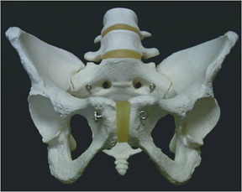
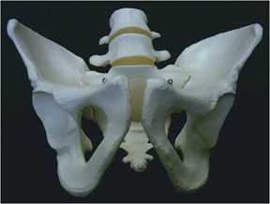
Forensic Anthropology:
Gender Determination (continued)
FEMALE PELVIS
MALE PELVIS

Slide 10
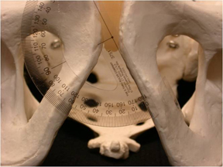
Forensic Anthropology:
Gender Determination (continued)
Male
or
Female?
Why?

Slide 11
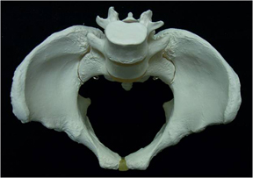
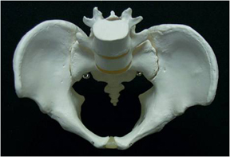
Forensic Anthropology:
Gender Determination (continued)
FEMALE PELVIC OPENING
MALE PELVIC OPENING

Slide 12
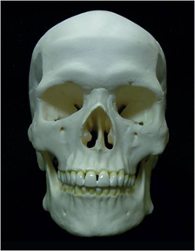
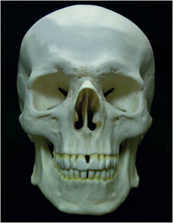
Forensic Anthropology:
Gender Determination (continued)
FEMALE SKULL
MALE SKULL

Slide 13
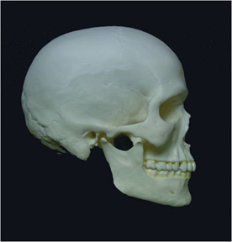
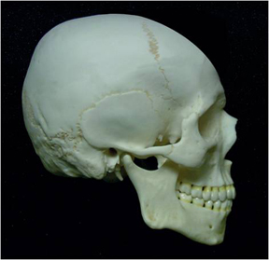
Forensic Anthropology:
Gender Determination (continued)
FEMALE SKULL
MALE SKULL

Slide 14
Forensic Anthropology:
Race Determination
    Most commonly divided into 3 categories
      Mongoloid (Asian or Native descent)
      Caucasoid (European)
      Negroid (African)

Slide 15
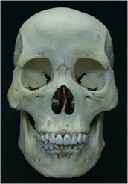
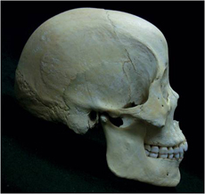
Forensic Anthropology:
Race Determination (continued)
Mongoloid (Asian or Native descent)
  Flat or projected outward frontal plane
  Small, rounded nasal cavities
  Circular eye orbits

Slide 16
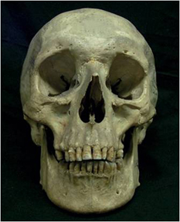
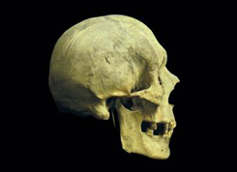
Forensic Anthropology:
Race Determination (continued)
Caucasoid (European)
  Flat cranium
  Long, narrow nasal cavities
  Oval eye orbits

Slide 17
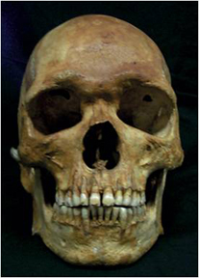
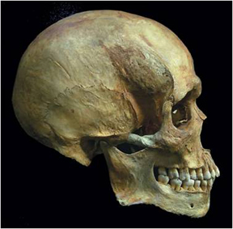
Forensic Anthropology:
Race Determination (continued)
Negroid (African)
  Cranium projected outward
  Wide nasal cavity
  Square eye orbits

Slide 18
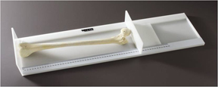
Forensic Anthropology:
Height Determination
Determined by measuring the long bones and calculating from known equations
The equations are different based on the bone, the race of the individual, and the gender
The long bones used are the femur, radius, tibia, and humerus

Slide 19
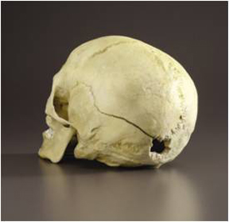

Forensic Anthropology:
Other Determining Factors
A forensic anthropologist or sculptor may create facial reconstructions from skulls to help identify skeletal remains
Pathological identities such as past surgeries, and broken bones that show healing and/or scarring
Trauma may be studied by observing cracks, holes, or toolmarks present on bones

Slide 20
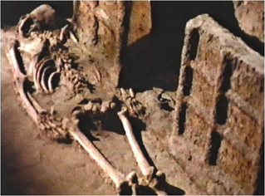
Excavation of Skeletal Remains
These are the guidelines provided to expose and recover remains in order to minimize damage
Guidelines will differ based on scene conditions

Slide 21
Excavation of Skeletal Remains (continued)
Steps to excavation
  Remove litter and vegetation if present
  Stake out and map the exact excavation area
  Determine the grave outline and remove the soil covering; sift each layer to check for evidence or small bones
  Work in horizontal layers
  Document as work continues with photography, maps, inventory, and measurements
  Once all bones have been exposed, document them again
  Remove each bone separately and bag it individually

Slide 22

Forensic Odontology
Odontology is the study of teeth and bite marks for individual identification
  Can estimate age by observing deciduous teeth in children and wear patterns in older adults
  Can be compared to dental records
  May contain DNA
  Teeth are harder to destroy in fire than bone
  Can be used with bite mark identification

Slide 23
Human Death
If death has occurred, the following must be determined:
  Cause
    The disease or injury responsible for initiating the sequence of events that resulted in death
    Examples
      Gunshot wound
      Drug overdose
      Cardiovascular disease

Slide 24
Human Death (continued)
Manner
  The “reason” the cause of death occurred
  Categories
    Accidental
    Homicidal
    Natural
    Suicidal
    Undetermined

Slide 25
Human Death (continued)
Mechanism
  The immediate physiological derangement resulting in death
  Examples
    Hemorrhage
    Cardiac arrhythmia

Slide 26
Forensic Anthropology:
Stages of Decomposition
STAGE | CHARACTERISTICS
Fresh | Immediately after death Blood is not pumping, so it drains and pools to lower parts creating livor mortis, or lividity Rigor mortis, the stiffening of the muscles, can also be seen
Bloat | When anaerobic metabolism causes gases to build up, making a body swell or bloat Can cause fluids to leak or “purge” from orifices
Active Decay | Greatest body mass loss Most of the tissue is liquefied Strong odors persist Much of the maggot mass pupates
Advanced Decay | Little insect activity Bones are revealed
Dry Remains | All that remains is dry skin, cartilage, and bones either partially or fully skeletonized

Slide 27
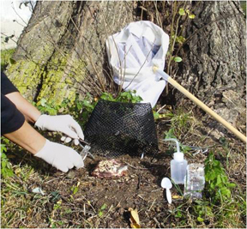
Forensic Entomology
Forensic entomology is the study of insects and their life cycles to determine how long a body has been deceased
When a dead body is present, necrophilious insects, or insects that feed on dead tissue, will usually infest it within 24 hours

Slide 28
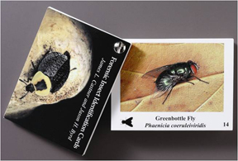
Forensic Entomology (continued)
The first and most commonly found insect is the adult blow fly, along with eggs, larvae, and pupae

Slide 29
Forensic Entomology (continued)
Other insects include
  Several types of beetles that can either be necrophilious or predatory on other insects
  Predator insects that prey on necrophilious insects

Slide 30
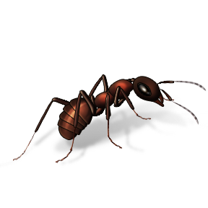
Forensic Entomology (continued)
Omnivorous insects such as ants and wasps that may feed on the body itself, other insects, or surrounding vegetation
Indigenous insects, and/or spiders, may be present, but their presence is usually coincidental to the location of the body

Slide 31
Forensic Entomology (continued)
The timeframe for lifecycle development is influenced by environmental conditions such as
  Climate
  Weather
  Geographical location
  Drugs or toxins present in the body

Slide 32
Resources
Saferstein, Richard. Forensic Science: An Introduction. New Jersey: Pearson Prentice Hall, 2008
Saferstein, Richard. Forensic Science: An Introduction. 2nd ed. New Jersey: Pearson Prentice Hall, 2011
Saferstein, Richard. Criminalistics: An Introduction to Forensic Science. 8th ed. Upper Saddle River, NJ; Pearson Prentice Hall, 2004
Do an Internet search for the following articles:
  forensic science central John Wayne Gacy
  forensic anthropology by Katherine Ramsland

