Slide 1
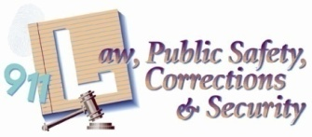
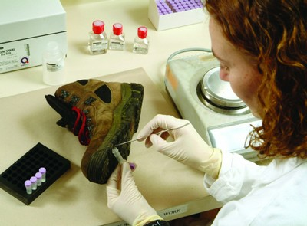
History of Forensic Science

Slide 2
Copyright and Terms of Service
Copyright © Texas Education Agency, 2011. These materials are copyrighted © and trademarked ™ as the property of the Texas Education Agency (TEA) and may not be reproduced without the express written permission of TEA, except under the following conditions:
1) Texas public school districts, charter schools, and Education Service Centers may reproduce and use copies of the Materials and Related Materials for the districts’ and schools’ educational use without obtaining permission from TEA.
2) Residents of the state of Texas may reproduce and use copies of the Materials and Related Materials for individual personal use only, without obtaining written permission of TEA.
3) Any portion reproduced must be reproduced in its entirety and remain unedited, unaltered and unchanged in any way.
4) No monetary charge can be made for the reproduced materials or any document containing them; however, a reasonable charge to cover only the cost of reproduction and distribution may be charged.
Private entities or persons located in Texas that are not Texas public school districts, Texas Education Service Centers, or Texas charter schools or any entity, whether public or private, educational or non-educational, located outside the state of Texas MUST obtain written approval from TEA and will be required to enter into a license agreement that may involve the payment of a licensing fee or a royalty.
Contact TEA Copyrights with any questions you may have.

Slide 3
Forensic Science
the application of science to the court of law
Criminalistics
the application of scientific techniques
in collecting and analyzing physical
evidence

Slide 4
Before 17th century
Confrontation by the accuser
Confession under torture
Strength to resist the pain
GUILTY
INNOCENT
1

Slide 5
Carl Wilhelm Scheele
1775
Swedish Chemist
Devised the test for detecting the poison arsenic in corpses
2

Slide 6
Alphonse Bertillon
French Anthropologist
Introduced the Bertillon System (aka Anthropometry) in 1879
Used various measurements of the body to identify people by their physical appearance
Replaced by Fingerprinting after the Will West case in 1903
3

Slide 7
Valentin Ross
German Chemist
1806
Discovered a more precise method for detecting small amounts of Arsenic
Mathieu Orfilla
Spain
1814
Father of Forensic Toxicology
Published the first scientific treatise on the detection of poisons
4

Slide 8
1828 – The Invention of the Polarized Light Microscope
5
1839 –
First microscopic
detection of sperm
6

Slide 9
James Marsh
Scottish Chemist
1839
The first to testify in a criminal trial on the detection of Arsenic in a victim’s body
7
Copyright © Texas Education Agency 2011. All rights reserved.
Images and other multimedia content used with permission.

Slide 10
–
The first presumptive test for blood
8
1850’s – 1860’s –
Development in photography and
Improved records in forensic science
9

Slide 11
Hans Gross
Austrian prosecutor and judge
1893
Published Criminal Investigation
Discussed the benefits of science (microscopy, chemistry, physics, zoology, botany, geology and fingerprinting) in criminal investigations
10

Slide 12
Karl Landsteiner
1901
Discovered ABO Blood typing
11
Albert Osborn
1910
Published Questioned Documents
12

Slide 13
Edmond Locard
1877-1966
French doctor/criminologist
Locard’s Exchange Principle
Opened the very first crime laboratory in France
13

Slide 14
Walter McCrone
1916-2002
American chemist
Microscopy expert
Examined The Shroud of Turin and the Vinland map
14

Slide 15
History of Crime Labs in the United States
–
Los Angels PD Crime Lab (the 1st crime lab in US)
1930’s –
University of CA at Berkeley Dept. of Criminalistics
headed by Paul Kirk
–
FBI Director J. Edgar Hoover opens the FBI Laboratory
1981 –
FBI opens Forensic Science Research and Training Center

Slide 16
Federal Crime Laboratories
FBI Laboratory (Quantico, VA)
Drug Enforcement Administration (DEA) Laboratories
Bureau of Alcohol, Tobacco, Firearms and Explosives (ATF) Laboratories
U.S. Army Crime Investigation Laboratory
(Fort Gillem, GA)
U.S. Postal Inspection Service Laboratories

Slide 17
Crime Labs Abroad
The British Home Office
Metropolitan Police Laboratory (London)
5 other regional labs
Canada
Royal Canadian Mounted Police (RCMP) Laboratories
Centre of Forensic Sciences (Toronto)
The Institute of Legal Medicine and Police Science (Montreal)

Slide 18
Resources
Saferstein, Richard. Forensic Science: An Introduction. New Jersey: Pearson Prentice Hall, 2008.
Bertino, Anthony J. Forensic Science: Fundamentals and Investigations. Mason, OH: South-Western Cengage Learning, 2009.
http://www.crimemuseum.org/library/forensics/origins.html

