Slide 1
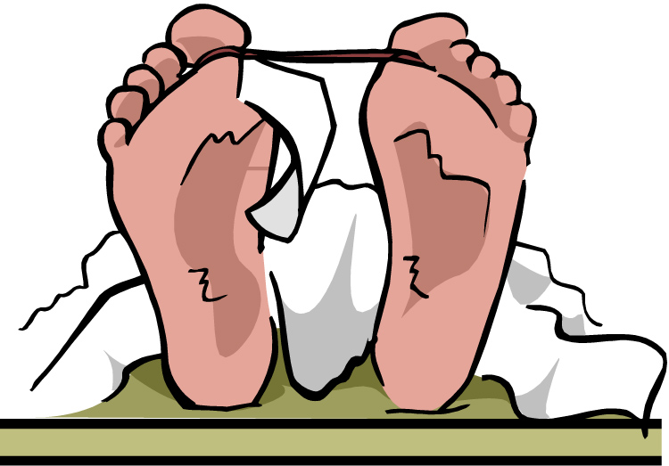
Role of Forensic Pathologists and Anthropologists
Forensic Science

Slide 2
Copyright and Terms of Service
Copyright © Texas Education Agency, 2011. These materials are copyrighted © and trademarked ™ as the property of the Texas Education Agency (TEA) and may not be reproduced without the express written permission of TEA, except under the following conditions:
1) Texas public school districts, charter schools, and Education Service Centers may reproduce and use copies of the Materials and Related Materials for the districts’ and schools’ educational use without obtaining permission from TEA.
2) Residents of the state of Texas may reproduce and use copies of the Materials and Related Materials for individual personal use only, without obtaining written permission of TEA.
3) Any portion reproduced must be reproduced in its entirety and remain unedited, unaltered and unchanged in any way.
4) No monetary charge can be made for the reproduced materials or any document containing them; however, a reasonable charge to cover only the cost of reproduction and distribution may be charged.
Private entities or persons located in Texas that are not Texas public school districts, Texas Education Service Centers, or Texas charter schools or any entity, whether public or private, educational or non-educational, located outside the state of Texas MUST obtain written approval from TEA and will be required to enter into a license agreement that may involve the payment of a licensing fee or a royalty.
Contact TEA Copyrights with any questions you may have.

Slide 3
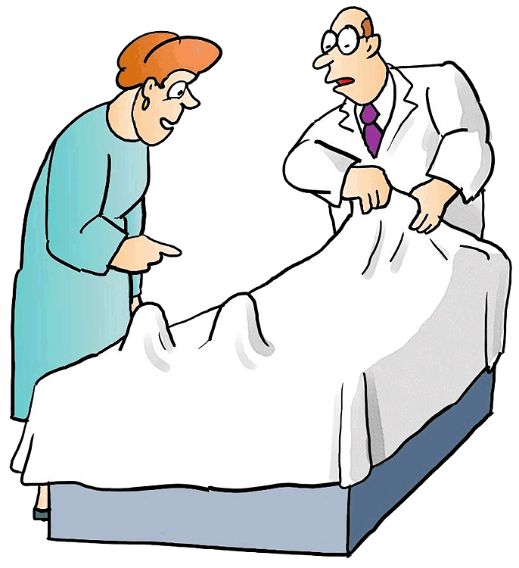
Definition: Pathologist vs. Forensic Pathologist
Pathologist
A physician who examines and analyzes tissue samples to identify irregularities and diseases
Forensic Pathologist
A specialist who determines the cause and manner of death of the deceased

Slide 4
Forensic Pathologist: History
The Middle Ages
Autopsies were
Performed to establish cause of death in humans
Well documented
Studied to help doctors discover more about human anatomy
The mid-1800’s
Rudolf Virchow
Was a German physician
Known as the father of modern pathology
Explained how disease arose in the individual cells and its effects on tissues and organ systems

Slide 5
Forensic Pathologist: History (continued)
1955
G.S.W. de Saram
Published detailed measurements of body temperature decrease in executed prisoners
Used these temperatures to establish time of death

Slide 6
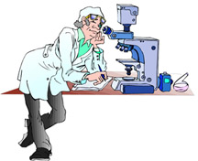
Forensic Pathologist: Primary Role
Assist law enforcement agencies with unexpected, sudden, or violent deaths
Determine cause, mechanism, and manner of death

Slide 7
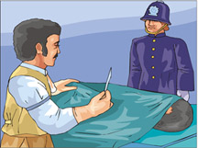
Cause of Death (COD)
Is the underlying disease, injury, abnormality, or poisoning that results in a person’s dying
Examples of COD
Gunshot wound
Skull fracture
Heart attack
Arsenic poisoning
If COD cannot be determined by initial observation then an autopsy is performed
Autopsy: a medical external and internal examination of a body to determine COD

Slide 8
Mechanism of Death
Is the physiological reason that a person dies
Examples
A gunshot wound to the chest is the COD, but the mechanism of death is exsanguination (bleeding to death)
Drug overdose is the COD, but the mechanism of death could be heart failure

Slide 9
Manner of Death
There are 5 categories into which the manner of death can fall
Natural
Accidental
Suicide
Homicide
Undetermined

Slide 10
Forensic Pathologist: Other Responsibilities
Perform Autopsies
Collect evidence on the body (hair, blood, fibers, etc.)
Issue death certificates
Assist with the ID of the deceased
Establish time and date of death
Possibly notify the next of kin
Act as an expert witness in court

Slide 11
Forensic Pathologist: Career Information
Usually holds other titles like medical examiner, coroner, or medico-legal death investigator
People who hold these titles are usually appointed to the position of forensic pathologist
Medico-legal – applying medical science to law
However, people who hold these titles do not necessarily have to be forensic pathologists

Slide 12
Forensic Pathologist: Career Information (continued)
Education
High School diploma/equivalent
Bachelor’s degree
major doesn’t matter,
must complete pre-requisites for medical school
Attend medical school and obtain a MD or DO degree
After med school, complete 5 years of residency/training
Certifications and Licenses
Must have a license to practice medicine
Become board certified
Pass the exam given by the American Board of Pathology

Slide 13
Forensic Pathologist: Career Information (continued)
Other requirements
Have a keen eye for detail
Work well under pressure
Be able to accept that they hold a great deal of responsibility
Communicate well with others
Be able to keep calm and patient
Be thorough and confident in their findings

Slide 14
Forensic Pathologist: Career Information (continued)
Where they work:
State governments
City or county governments
Colleges, universities, or medical schools
The military
The federal government
Private groups or practices
Hospitals
Salary and Benefits
$151,000-$308,000 annually (in 2012)
Paid vacation
Health, disability, and life insurance
Retirement or pension plans
Work a 40-hour week, but are called in if there is a death emergency

Slide 15
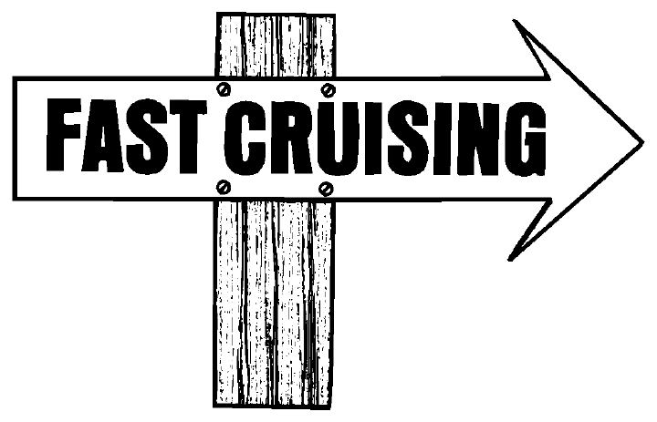
Forensic Pathologist: Career Information (continued)
Outlook for the career choice
Growing faster than average
Population increasing means more deaths that need analyzing by forensic pathologists

Slide 16
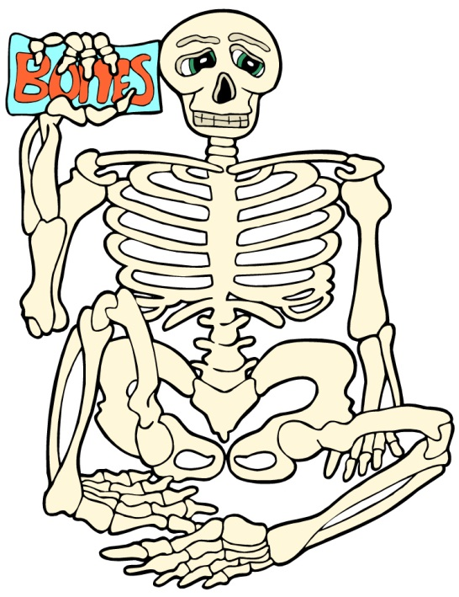
Definition: Anthropologist vs. Forensic Anthropologist
Anthropologist
Has at least a master’s degree
Studies humanity
Studies humans’ physical, social, and language development, and the cultures they establish
Forensic Anthropologist
Examines the skeletal or decomposed remains in unexplained deaths

Slide 17
Forensic Anthropologist: History
1878
Known as the Father of Forensic Anthropology
Published an essay that uses parts of skeletal remains that can establish age, sex, or height
1939
W.M. Krogman
Published the book The Human Skeleton in Forensic Medicine
Although the term forensic anthropology is not used in the textbook it is used as a guide for many years

Slide 18
Forensic Anthropologist: History (continued)
1957
Thomas Mocker and T. Dale Stewart
Identified the growth stages of skeletal bones
Formed the basis of forensic anthropology
1971
Dr. William Bass starts the first “Body Farm” at the University of Tennessee

Slide 19
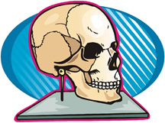
Forensic Anthropologist: Primary Role
To identify someone from skeletal, decomposed, or charred remains

Slide 20
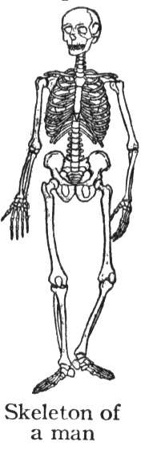
Forensic Anthropologist: Primary Role (continued)
Skeletal remains can tell a forensic anthropologist a large amount of information
Human or animal
Age
Sex
Height
Race
Possible skeletal injuries

Slide 21
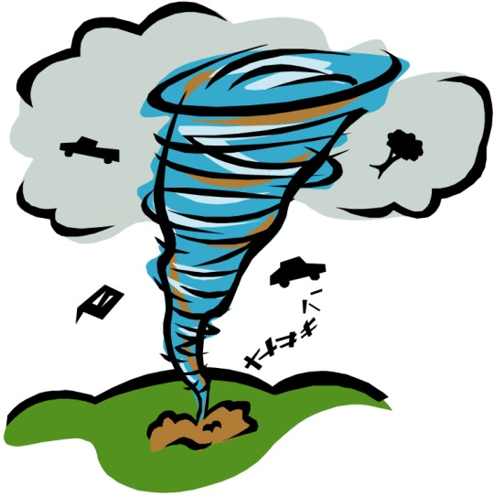
Forensic Anthropologist: Other Responsibilities
May assist pathologists with autopsies
May perform facial reconstruction to recreate a person’s face
Help search areas for remains and recover them
Act as an expert witness in court
Help identify victims in mass disasters
Plane Crashes
Natural Disasters
Terrorist Attacks

Slide 22
Forensic Anthropologist: Career Information
Education
After receiving a high school diploma
Obtain a bachelor’s degree in anthropology, anatomy, or osteology
Osteology is the scientific study of bones

Slide 23
Forensic Anthropologist: Career Information
Education
Complete graduate work in anthropology or forensic anthropology
It is important to pick a graduate program where you would like to work
Because most graduates in this field of study receive their first job at their university
Complete a doctorate (optional)
Needed to join the faculty at a college or university
Most places may hire people with a master’s degree on a temporary basis, but they usually need to be working on their doctorate

Slide 24
Forensic Anthropologist: Career Information
Certificates and Licenses
Complete certification through the American Board of Forensic Anthropology
Have a Ph.D.
Show experience in the field of study
Pass a practical exam and a written exam

Slide 25
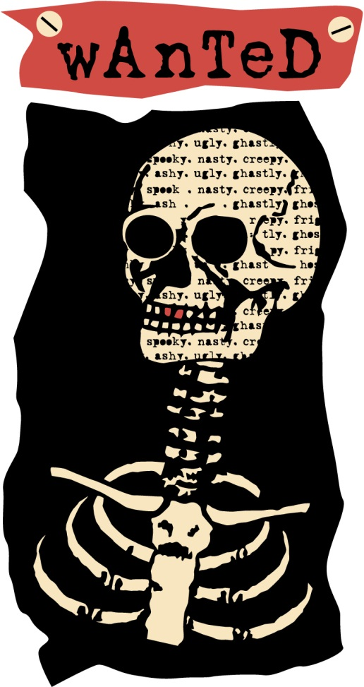
Forensic Anthropologist: Career Information (continued)
Other requirements
Work well with a team
Have a desire for knowledge
Communicate well with others
Have good writing skills
Be able to train and teach others

Slide 26
Forensic Anthropologist: Career Information (continued)
Where they work
Colleges or universities
Most work here and are brought in for cases
Research institutions
Medical examiner’s offices
Law enforcement agencies
Military
Salary and Benefits
Hard to find actual salary information for forensic anthropologist s
Regular anthropologists make between $32,000 and $117,000 (in 2012)
Earn $100 – 200 an hour as consultants
Vacation and sick time
Health and life insurance
Pension or 401K plans

Slide 27
Forensic Anthropologist: Career Information (continued)
Outlook for career
Growing more slowly than average
Because the forensic anthropology field is so small and the turnover is low
The number of applicants is larger than the number of positions available

Slide 28
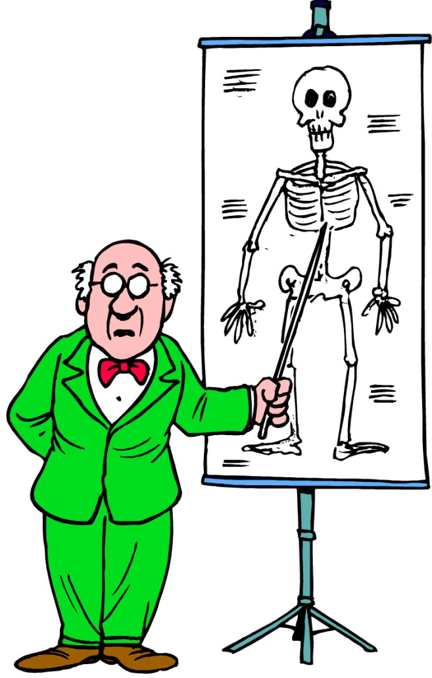
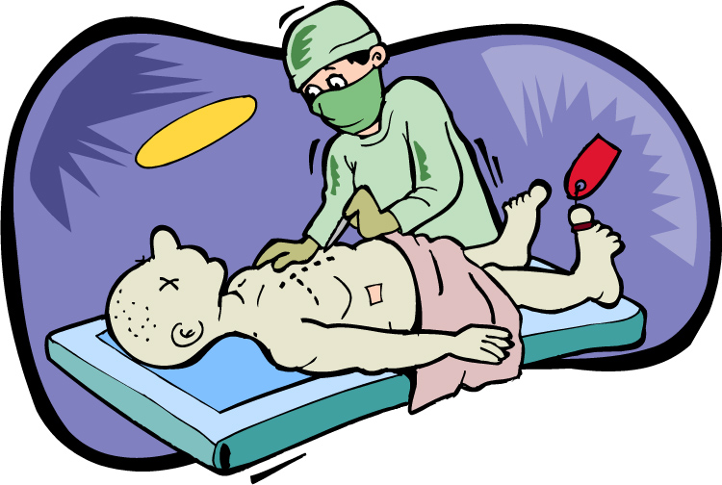
Forensic Pathologists vs.
Forensic Anthropologists

Slide 29
Differences
 | Concentration | Primary Concerns | Legal Authority
Forensic Pathologists | Center on fleshed bodies and soft tissue | Cause and manner of death of the victim | To perform autopsies State cause and manner of death Issue death certificates
Forensic Anthropologists | Center on skeletal remains and hard tissue | To find the identity of the victim | Analyze skeletal remains and present opinion, but not a legal statement

Slide 30
Similarities
These careers overlap since decomposition is a continuous process
Pathologists are helpful when mummified tissues exist
Anthropologists are helpful when decomposition is more advanced
Both work to determine the time since death, look for any evidence on deceased, and collect the evidence

Slide 31
Working Together
They will work together on cases with the investigators assigned
Both are a part of the medico-legal system if needed
Medico-legal systems are required for any of the following cases:
Non-natural deaths
Sudden deaths, not in a doctor’s care, of people under 50
Deaths in prison or other state-run institutions
Deaths of children that are less than 1 year old

Slide 32
Resources
Saferstein, Richard. Criminalistics: An Introduction to Forensic Science. Upper Saddle River, NJ: Prentice Hall, 2004.
Deslich, Barbara, and John Funkhouser. Forensic Science for High School. Dubuque, IA: Kendall/Hunt, 2006.
Careers in Focus. New York: Ferguson, 2010.
http://thename.org
http://www.theabfa.org

