Slide 1
Evidence: Individual or Class?
Discussion Activity

Slide 2
Copyright and Terms of Service
Copyright © Texas Education Agency, 2011. These materials are copyrighted © and trademarked ™ as the property of the Texas Education Agency (TEA) and may not be reproduced without the express written permission of TEA, except under the following conditions:
1) Texas public school districts, charter schools, and Education Service Centers may reproduce and use copies of the Materials and Related Materials for the districts’ and schools’ educational use without obtaining permission from TEA.
2) Residents of the state of Texas may reproduce and use copies of the Materials and Related Materials for individual personal use only, without obtaining written permission of TEA.
3) Any portion reproduced must be reproduced in its entirety and remain unedited, unaltered and unchanged in any way.
4) No monetary charge can be made for the reproduced materials or any document containing them; however, a reasonable charge to cover only the cost of reproduction and distribution may be charged.
Private entities or persons located in Texas that are not Texas public school districts, Texas Education Service Centers, or Texas charter schools or any entity, whether public or private, educational or non-educational, located outside the state of Texas MUST obtain written approval from TEA and will be required to enter into a license agreement that may involve the payment of a licensing fee or a royalty.
Contact TEA Copyrights with any questions you may have.

Slide 3
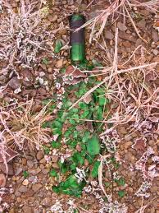
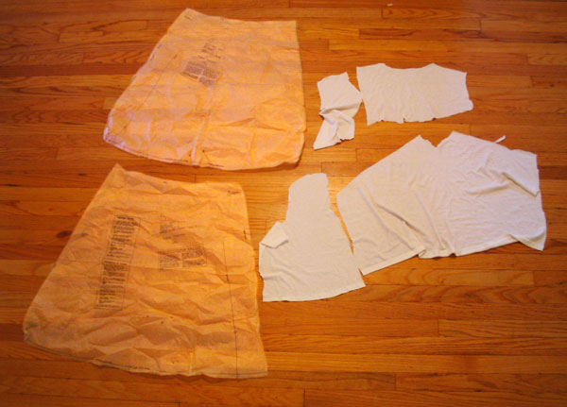
Evidence: Individual or Class?
1. Several pieces of torn T-shirt were found close to a homicide victim. A torn T-shirt was found in the suspect’s bedroom. Can the torn T-shirt and the pieces be individualized. Explain.
2. Can very small glass fragments be individualized, or uniquely associated with a broken bottle? Explain

Slide 4
Evidence: Individual or Class? (continued)
At the scene of a robbery a partial note was found on a torn piece of paper. A similar piece of torn paper, that seemed to complete the original sheet of paper and note, was found at the suspect’s office. Can these torn pieces of paper be individualized to each other? Explain.
Can the handwriting be individualized to the same person from both sources of the torn paper? Can fingerprints on the note(s) be individualized to the person?
Explain.

Slide 5
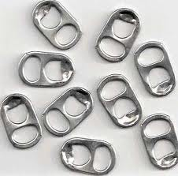
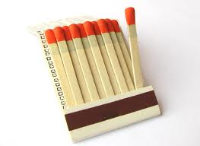
Evidence: Individual or Class? (continued)
Several tabs from soda can’s were found in a suspect’s kitchen. A soda can was found at the scene of the crime that could be uniquely associated with one of the tabs. How is this possible?
A suspect was found with a book of matches (some were missing) in his pocket. At the scene of a known arson matches were found. Are the matches from the scene, individual or class evidence? Explain.

Slide 6
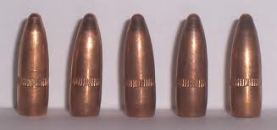
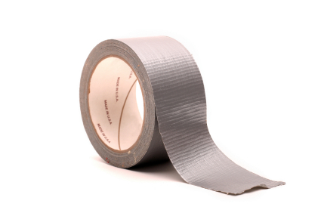
Evidence: Individual or Class? (continued)
A gun was found in a suspect’s car, these bullets were retrieved from the murder scene. Can these bullets be individualized to the gun? Explain.
A piece of duct tape was used to close a victim’s mouth during a kidnap-ping. A roll of the same brand of duct tape was found in the suspect’s garage. Would this be considered class or individual evidence? Explain.

Slide 7
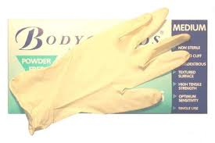
Evidence: Individual or Class? (continued)
The sports section of the newspaper was found at a robbery scene. The finance section was found at the suspect’s office. Was the finance section individual or class evidence? Explain.
At a homicide scene one latex glove was found. A box of latex gloves were found in a suspect’s kitchen. Can the gloves be individ-ualized to the box? Explain.

